Slide 1
Predicting Company Bankruptcies

Slide 2
Problem Statement
• Many organizations struggle to identify financial distress before bankruptcy occurs. Traditional financial analysis often fails to capture complex relationships between multiple financial variables.
The objective of this project is to build a machine learning model capable of accurately predicting whether a company is financially healthy or at risk of bankruptcy.

Slide 3
Objectives
Analyze financial data of companies.
Perform data cleaning and preprocessing.
Explore important financial indicators.
Build multiple machine learning models.
Compare model performance.
Identify the most accurate model for bankruptcy prediction.

Slide 4
Dataset Overview
Dataset
Source: Company Financial Dataset
Industry: Corporate Finance
Target Variable:
0 → Healthy Company
1 → Bankrupt Company
Dataset Features
Liquidity Ratios
Profitability Ratios
Solvency Ratios
Cash Flow Ratios
Operational Efficiency Metrics

Slide 5
1.Methodology 2.Data Collection 3.Data Cleaning 4.Exploratory Data Analysis 5.Feature Selection 6.Data Splitting 7.Model Building 8.Model Evaluation 9.Performance Comparison
Project Workflow

Slide 6
The dataset was prepared before training the models. Steps Performed: 1.Removed duplicate records 2.Checked missing values 3.Standardized numerical features 4.Balanced target classes where required 5.Split data into training and testing datasets Proper preprocessing improves model accuracy and reduces prediction errors
Data Preprocessing

Slide 7
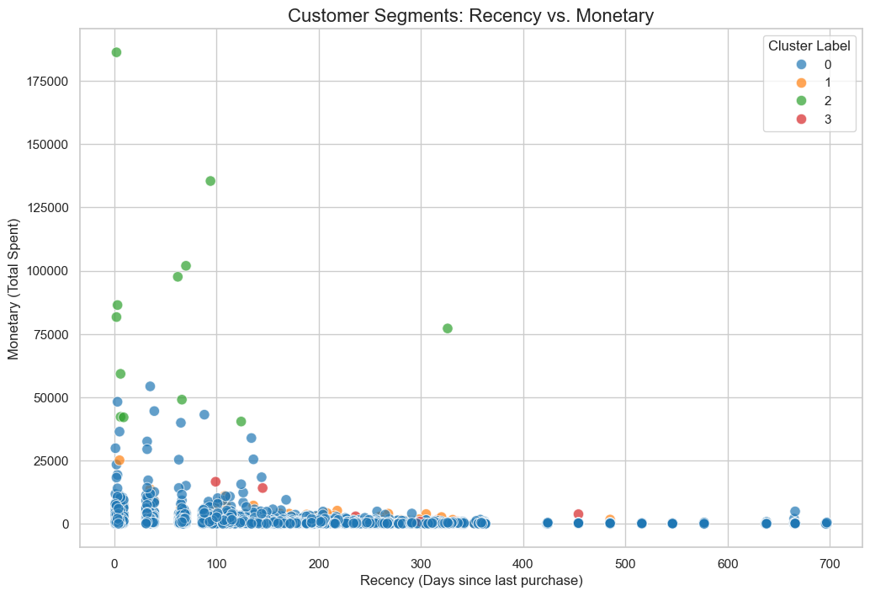
Exploratory Data Analysis
Exploratory Data Analysis
EDA was conducted to understand the structure and characteristics of the dataset.
Key observations include:
Distribution of bankrupt and non-bankrupt companies
Correlation among financial variables
Detection of outliers
Identification of highly influential features

Slide 8
Machine Learning Models
Models Implemented
Several classification algorithms were trained and evaluated:
Logistic Regression
Decision Tree
Random Forest
Voting Classifier
Each model was assessed using the same training and testing data.

Slide 9
Model Evaluation Metrics
Evaluation Metrics
The models were evaluated using:
Accuracy
Precision
Recall
F1-Score
ROC-AUC Score
Confusion Matrix
These metrics provide a complete understanding of classification performance.

Slide 10
Confusion Matrix
Confusion Matrix
The confusion matrix illustrates how well the model distinguishes between bankrupt and healthy companies.
It displays:
True Positives
True Negatives
False Positives
False Negatives

Slide 11
Performance Camparison
Performance Comparison
Random Forest and the Support Vector Classifier achieved the highest prediction performance due to their ability to capture
complex relationships within the financial data.
Model | Accuracy
Logistic Regression | 0.846
Decision Tree | 0.792
Random Forest | 0.866
Support Vector Classifier | 0.810

Slide 12
Conclusion
This project demonstrates that machine learning can successfully identify companies at risk of bankruptcy using financial indicators.
Among the evaluated algorithms, ensemble methods produced the best overall performance, making them suitable for real-world financial risk assessment. The developed model can support organizations in making proactive and data-driven financial decisions.

